Slide 1

OOSE Based Application Developmet

Slide 2
The objectives of the course
1.Understand software engineering concepts a long with their applicability contexts.
2.Given a problem, identify domain objects, their properties and relationships among them.
3. Identify and model/represent domain constraints on the objects and (or) on their relationships
4. Develop design solutions for problems on various O-O concepts
5.Learn various modelling techniques to model different perspectives of object-oriented software design (UML)

Slide 3
COURSE OUTCOMES
1. Describe the OOAD paradigm (Unified Processes)
2. Employ the UML diagramming standards.
3. Demonstrate the use of a software tool to support the
planning, analysis and design phases
4. Use a case tool for all UML diagrams.
5. Develop prototypes of the system design, code, and Testing

Slide 4
SYLLABUS
Module I: Introduction to Software Engineering
Introduction: Review of Software life cycle stages, Software Processes. Introduction to OOAD, comparison with Functional approach to software development.
Overview of UML: Use Case Diagrams, Class Diagrams, Interaction Diagrams, State Machine Diagrams, Activity Diagrams.
Modelling Concepts: Systems, Models, and Views. Data Types - Abstract Data Types, Instances. Classes - Abstract Classes, Objects, Event Classes, Events, Messages. Objects, Oriented Modelling- Falsification and Prototyping
Learning Outcomes:
After completion of this unit, the student will be able to:
1. Understands the basics of software engineering(L1)
2. Familiarize with usage of UML(L2)
3. Illustrate modelling concepts(L2)

Slide 5
Software Engineering
It is a Systematic approach to develop a software.
In this process we analyzing the user needs and Designing and
Constructing and Testing the end user Applications/Sofware.
The software is a collection of integrated programs and carefully-organized instructions and code written by developers on any of various particular computer languages.
Engineering is the application of scientific and practical knowledge to invent, design, build, maintain, and improve frameworks, processes, etc.
Software Engineering is an engineering branch related to the evolution of software product using well-defined scientific principles, techniques, and procedures.

Slide 6

Software Engineering: Definition
Software Engineering is a layered technology.
Software Engineering is a collection of techniques,methodologies and tools that help with the production of
a high quality software system
with a given budget
before a given deadline
while change occurs.
20

Slide 7
What is Software Engineering?
The IEEE Computer Society defines software engineering as:
The application of a systematic, disciplined, quantifiable approach to software development, operation, and maintenance; that is, the application of engineering to software.

Slide 8
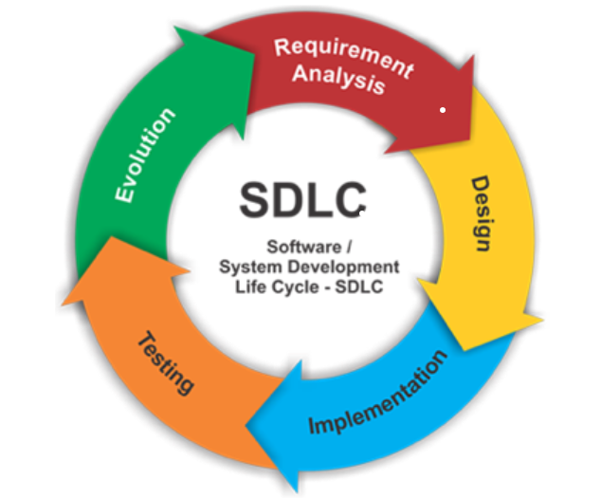
Software life cycle stages:

Slide 9
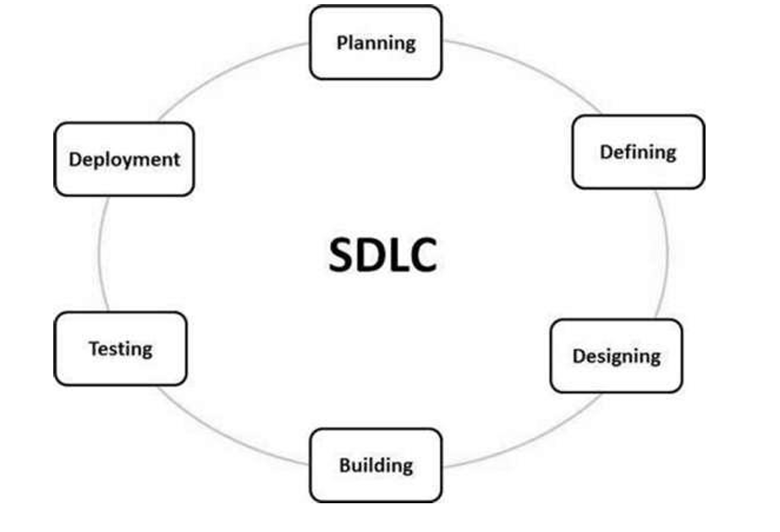

Slide 10
Review of Software life cycle stages:
1.Requirements Analysis:
Understand and document the requirements of the software.
Activities:
Gather and analyze requirements from stakeholders.
Define system functionalities and constraints.
Document user expectations and system specifications.
Deliverables: Requirements document.
2. System Design:
Create a blueprint for the software based on the gathered requirements.
Activities:
Design the overall architecture of the system.
Define data structures, software modules, and interfaces.
Create detailed specifications for components.
Deliverables: System architecture, design specifications.
There are two diagrams 1.ER Diagrams(Structural Programming Languages )
2.UML Diagrams(Object Oriented Programming Languages )

Slide 11
3.Implementation (Coding):
Translate the design into actual code.
Activities:
Write code based on the design specifications.
Conduct unit testing to ensure individual components work correctly.
Integrate components into a complete system.
Deliverables: Executable code.
4.Testing:
Verify that the software meets the specified requirements.
Activities:
Conduct various testing levels (unit, integration, system, acceptance).
Identify and fix defects.
Validate that the software meets user expectations.
Deliverables: Test plans, test cases, defect reports.

Slide 12
5.Deployment (Installation):
Release the software for actual use.
Activities:
Plan and execute the installation of the software.
Train end-users and support personnel.
Monitor and troubleshoot any issues during initial use.
Deliverables: Deployed software, user manuals.
6.Maintenance and Support:
Address issues, improve functionality, and ensure the software's continued usability.
Activities:
Fix defects and address user-reported issues.
Enhance features or add new features based on user feedback.
Update documentation.
Deliverables: Software updates, documentation updates.

Slide 13
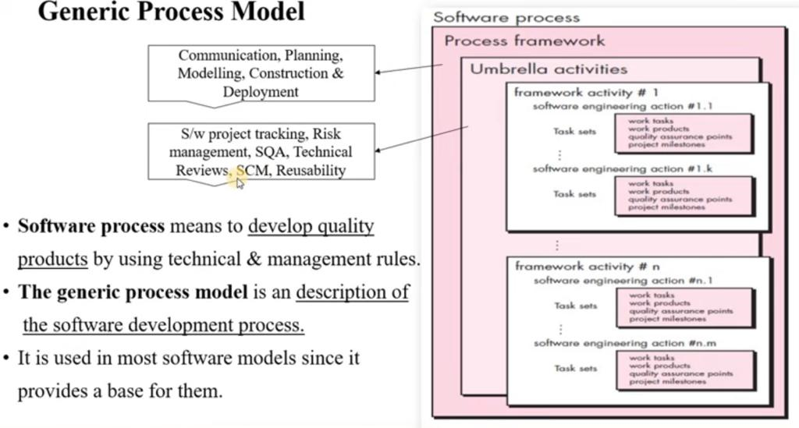
SOFTWARE PROCESS

Slide 14
SOFTWARE PROCESS
A process is a collection of activities, actions and tasks that are performed when some work product is to be created.
A GENERIC PROCESS FRAMEWORK (elements of a software process):
five activities:
•Communication
–Involves communication among the customer and other stake holders; requirements gathering.
•Planning
–Establishes a plan for software engineering work; addresses technical tasks, resources, work products, and work schedule.

Slide 15
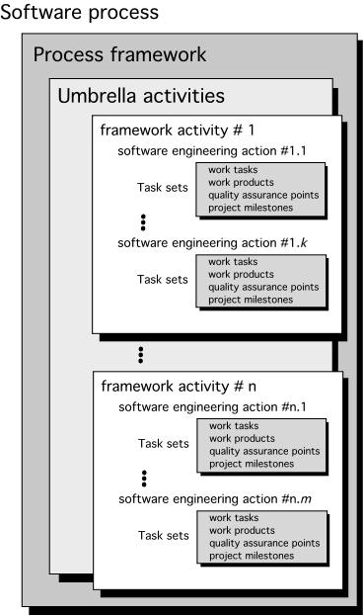
Modelling (Analyze, Design)
Creation of models to better under the requirements and the design.
Construction (Code, Test):
–Combines code generation and testing to uncover errors.
Deployment:
–Involves delivery of software to the customer for evaluation and feedback.

Slide 16
The umbrella activities in a software development life cycle processinclude the following:
1.Software project tracking and control: Compare the progress of the project with the plan.
2.Formal technical reviews: This includes reviewing the techniques that have been used in the project.
3.Software quality assurance: This is very important to ensure the quality measurement of each part to ensure them.
4.Software configurationmanagement:
managing different versions of these work products.
5.Document preparation and production:
All the project planning and other activities should be hardly copied and the production gets started here.

Slide 17
6.Re-usability management:
This includes the backing up of each part of the software project
7.Risk management:
Risk management is a series of steps that help a software team to understand and manage uncertainty.

Slide 18
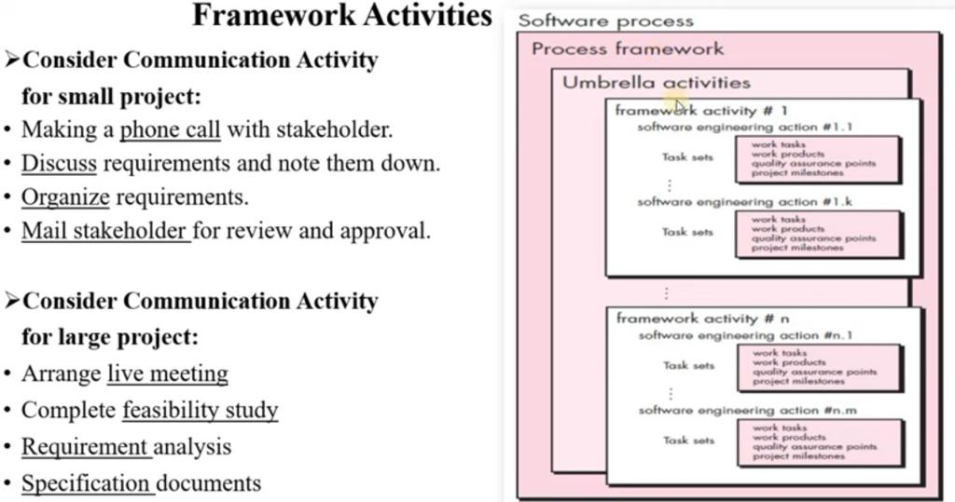

Slide 19
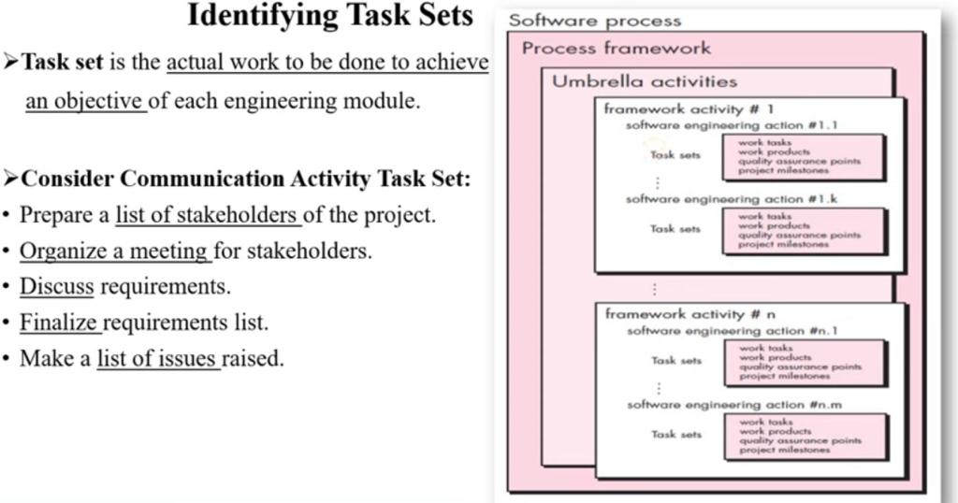

Slide 20
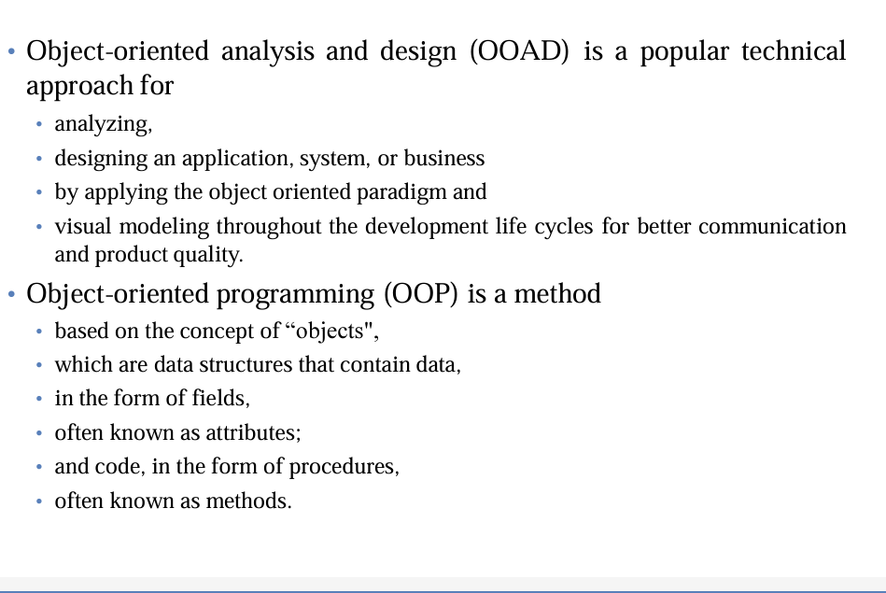
Object-Oriented Analysis and Design (OOAD):

Slide 21
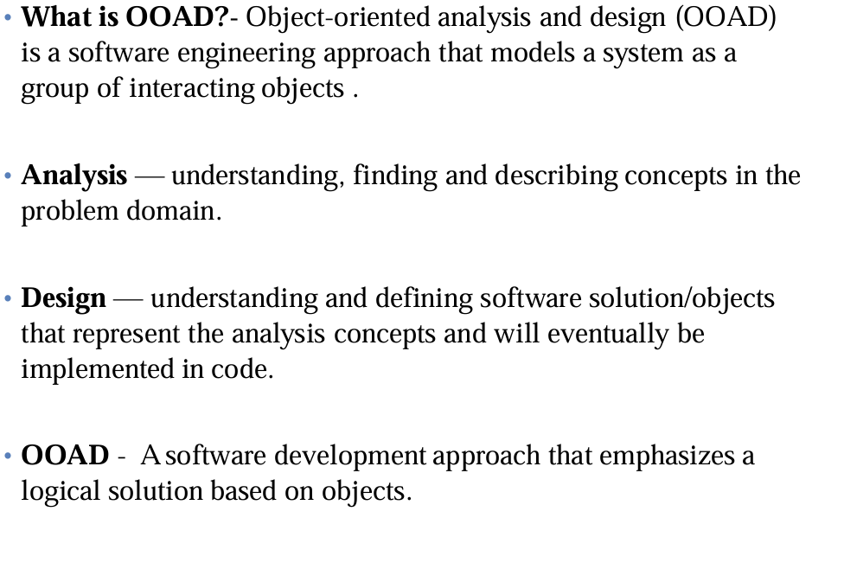

Slide 22
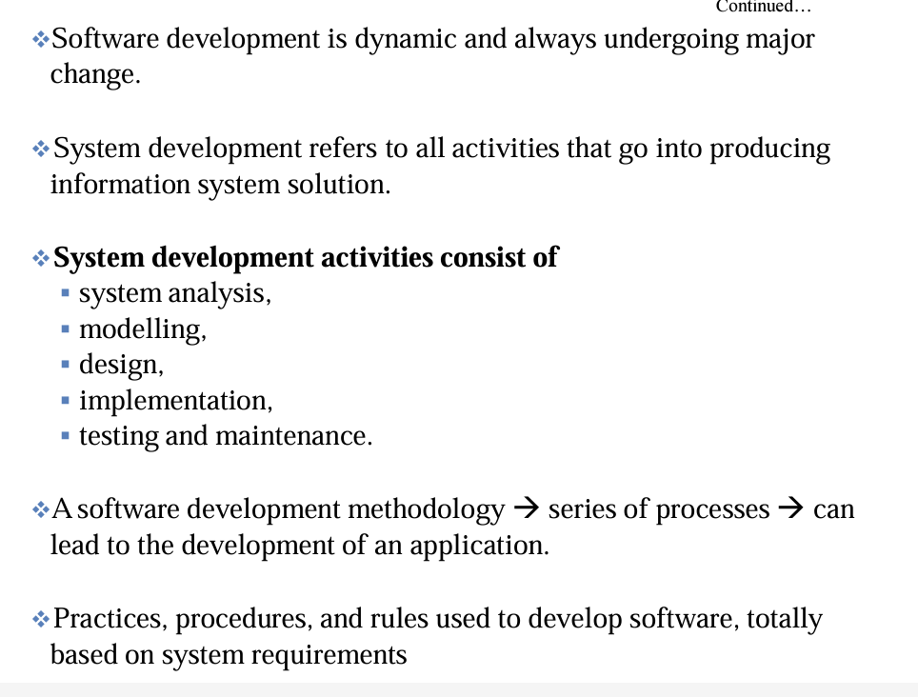

Slide 23
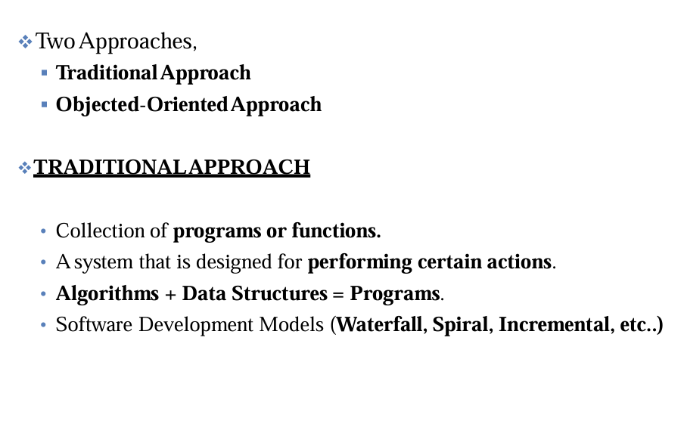

Slide 24
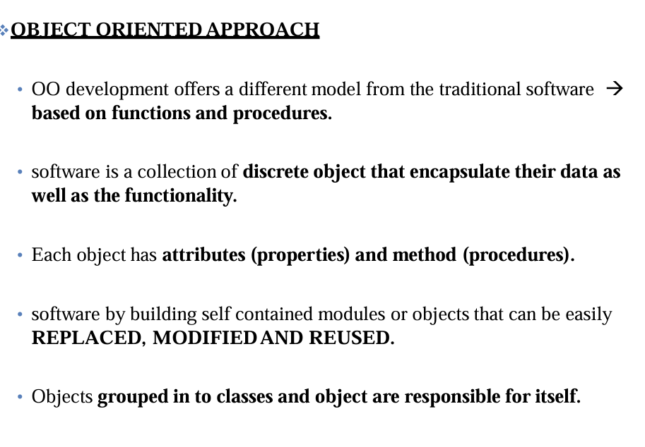

Slide 25
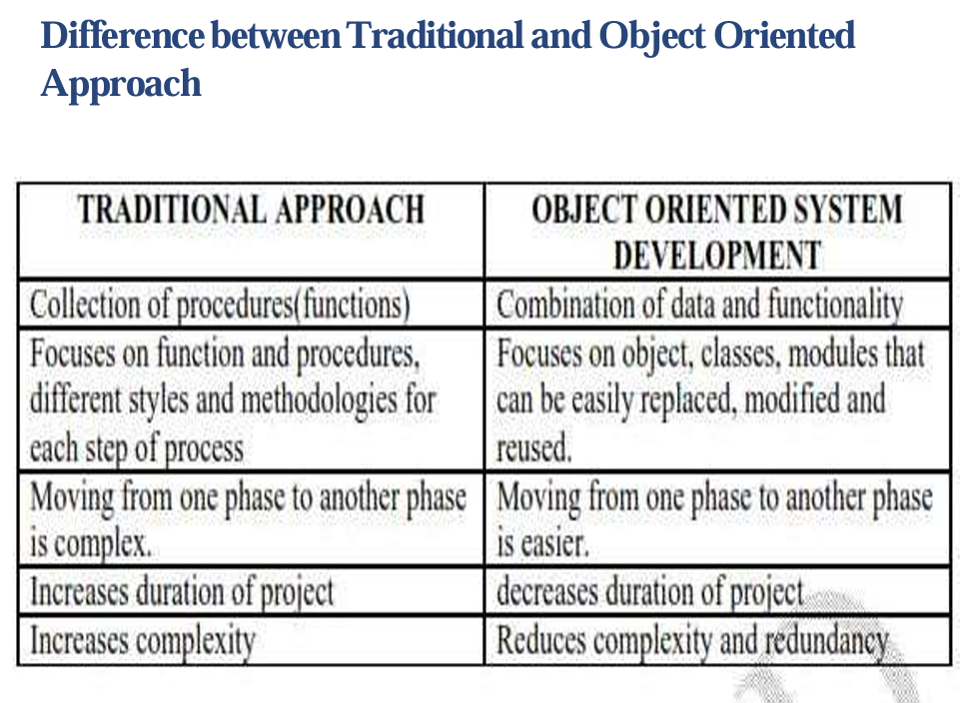

Slide 26
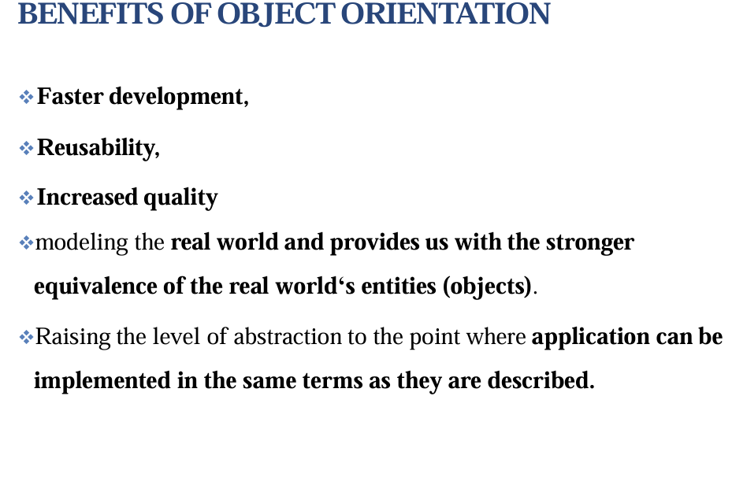
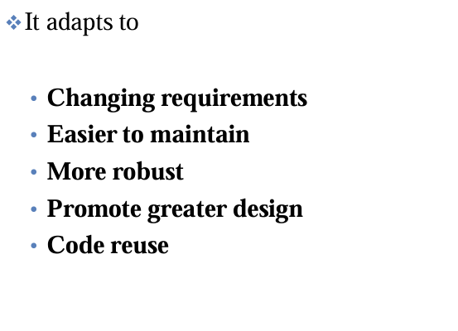
Benefits and uses of Object oriented concepts

Slide 27
Comparison with Functional approach to Software development.
Function Oriented Design (FOD):
In FOD, the primary focus is on functions or procedures that manipulate data.
The system is divided into functions, and data is shared among these functions.
Object Oriented Design (OOD):
OOD is centered around objects, which encapsulate data and the functions that operate on that data.
Objects are instances of classes, which define the properties (attributes) and behaviors (methods) shared by the objects

Slide 28
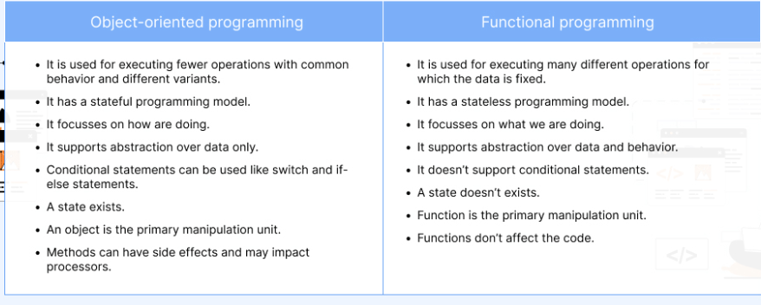

Slide 29
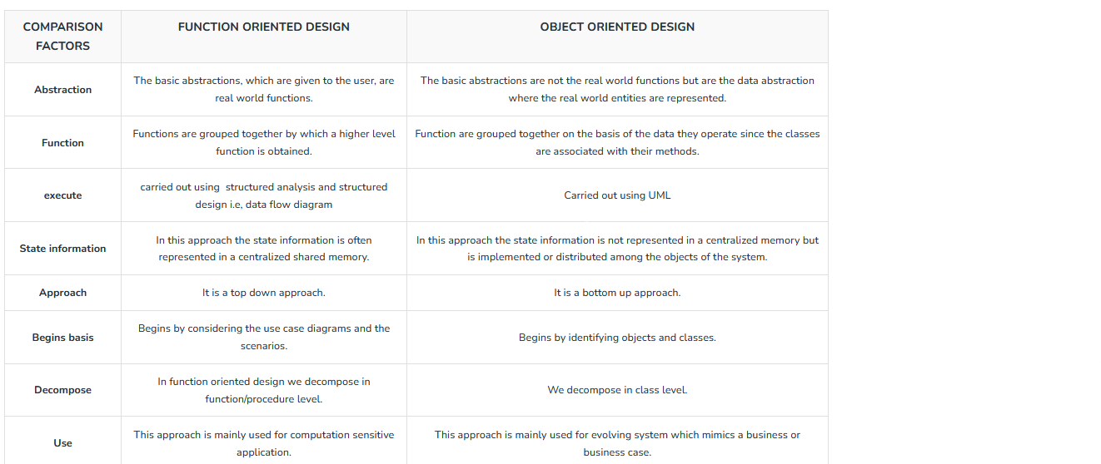
comparison with Functional approach to software development.

Slide 30
Overview of UML
Unified Modeling Language (UML) is a standardized modeling language used in software engineering to visually represent a system's design.
UML provides a set of graphical notations and diagrams that help developers, analysts, and stakeholders to communicate and understand the architecture, structure, behavior, and functionality of a system.
It was developed by the Object Management Group (OMG) and has become a widely adopted standard in the field of software development.

Slide 31
Use Case Diagrams
Use case diagrams represent the functionality of the system from a user’s point of view. They define the boundaries of the system.
Use Case Diagrams Use cases and actors Actors are external entities that interact with the system.
Elements:
Actor:
Represents an external entity that interacts with the system.
Can be a user, another system, or any external element.
Shown as stick figures or blocks outside the system boundary.
Use Case:
Represents a specific functionality or behavior of the system.
Describes a set of interactions between the system and external entities (actors).
Shown as ovals inside the system boundary.
System Boundary:
Represents the boundary of the system being modeled.
Contains actors and use cases.

Slide 32
Association:
Represents a relationship between an actor and a use case.
Indicates that the actor is involved in the described functionality.
Include Relationship:
Describes the inclusion of one use case by another.
Represents the fact that the behavior of the included use case is incorporated into the behavior of the base use case.
Extend Relationship:
Describes optional or exceptional behavior that can extend the behavior of a base use case.

Slide 33
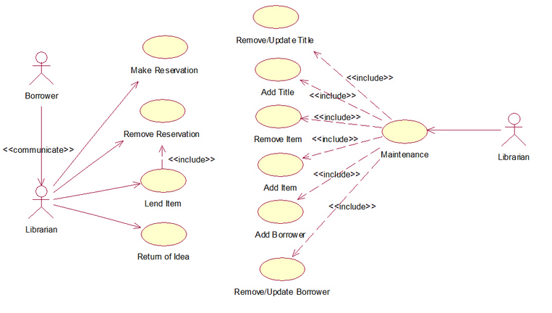
Example:
Consider a simple library management system:

Slide 34
Class Diagrams
Class Diagrams Classes and objects Class diagrams describe the structure of the system in terms of classes and objects.
Classes are abstractions that specify the attributes and behavior of a set of objects.
A class is a collection of objects that share a set of attributes that distinguish the objects as members of the collection.
Objects are entities that encapsulate state and behavior. Each object has an identity: it can be referred individually and is distinguishable from other objects.

Slide 35
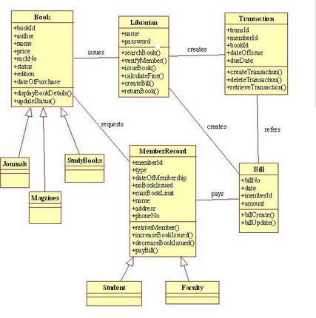
Example

Slide 36
Interaction Diagrams
Interaction diagrams are models that describe how a group of objects collaborate in some behavior - typically a single use-case.
Interaction Diagram are used in UML to establish communication between objects
Notation of an Interaction Diagram
Following are the different types of interaction diagrams defined in UML:
Sequence diagram
Collaboration diagram

Slide 37
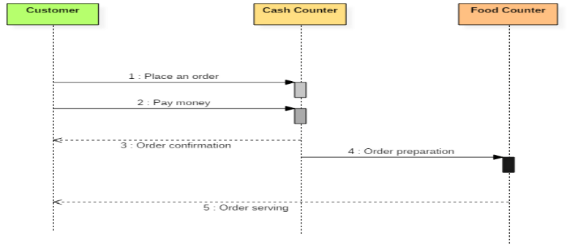
Sequence diagram example
The following sequence diagram example represents ordering system:

Slide 38
The ordered sequence of events in a given sequence diagram is as follows:
1.Place an order.
2.Pay money to the cash counter.
3.Order Confirmation.
4.Order preparation.
5.Order serving.
Collaboration Diagram:
Collaboration Diagram depicts the relationships and interactions among software objects. They are used to understand the object architecture within a system rather than the flow of a message as in a sequence diagram. They are also known as “Communication Diagrams.”

Slide 39
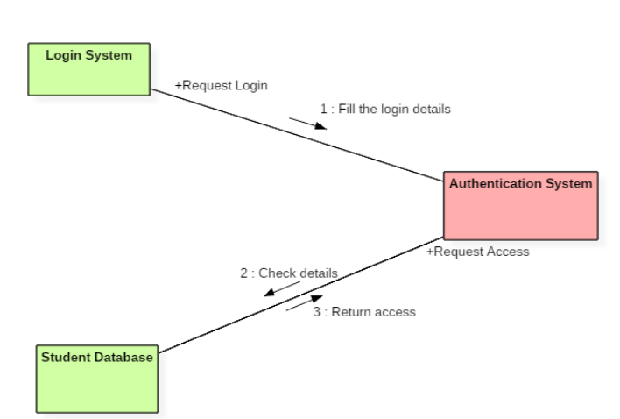
Collaboration diagram Example
Following diagram represents the sequencing over student management system:

Slide 40
State Machine Diagrams
State machine diagram typically are used to describe state-dependent behavior for an object.
An object responds differently to the same event depending on what state it is in. State machine diagrams are usually applied to objects but can be applied to any element that has behavior to other entities such as: actors, use cases, methods, subsystems systems and etc. and they are typically used in conjunction with interaction diagrams (usually sequence diagrams).
For example:
Consider you have $100,000 in a bank account. The behavior of the withdraw function would be: balance := balance - withdrawAmount; provided that the balance after the withdrawal is not less than $0; this is true regardless of how many times you have withdrawn money from the bank. In such situations, the withdrawals do not affect the abstraction of the attribute values, and hence the gross behavior of the object remains unchanged.

Slide 41
Activity Diagrams
An activity diagram is a type of Unified Modeling Language (UML) flowchart that shows the flow from one activity to another in a system or process.
It's used to describe the different dynamic aspects of a system and is referred to as a 'behavior diagram' because it describes what should happen in the modeled system.

Slide 42
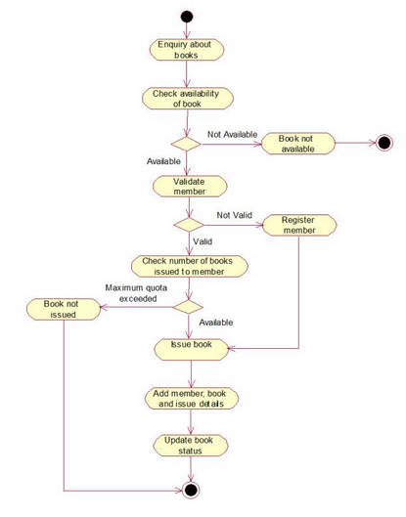
Activity Diagrams

